Slide 1
Creating a Whole Brain Yeo Functional Atlas; Supplementation via a Winner-Take-All Approach
Joel Bruss
Tranel, Boes Labs

Slide 2
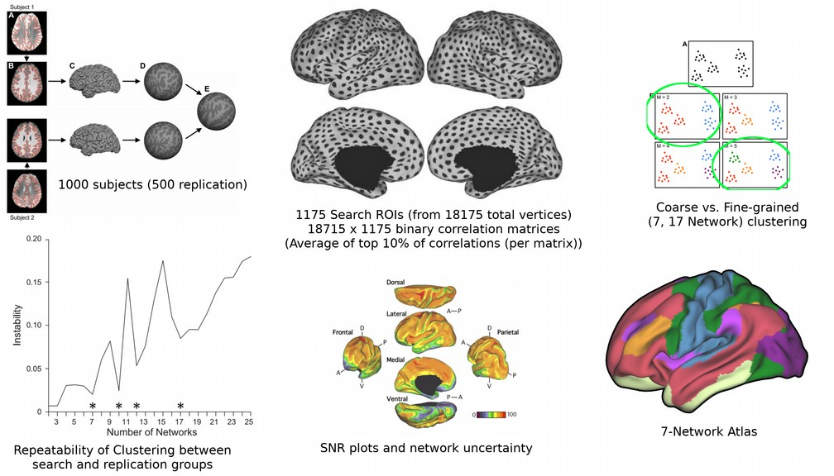
Yeo Atlas Workflow

Slide 3
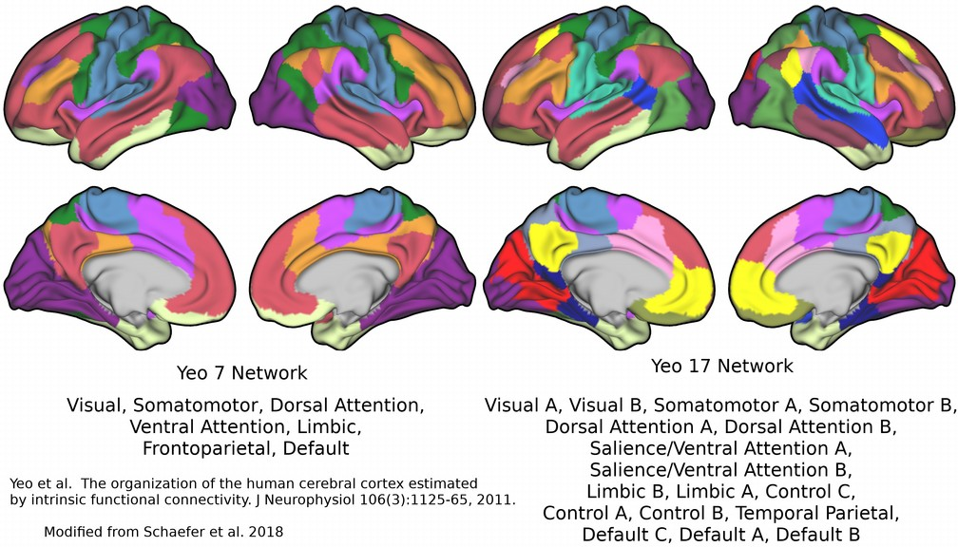
Yeo 7/17 Functional Networks

Slide 4
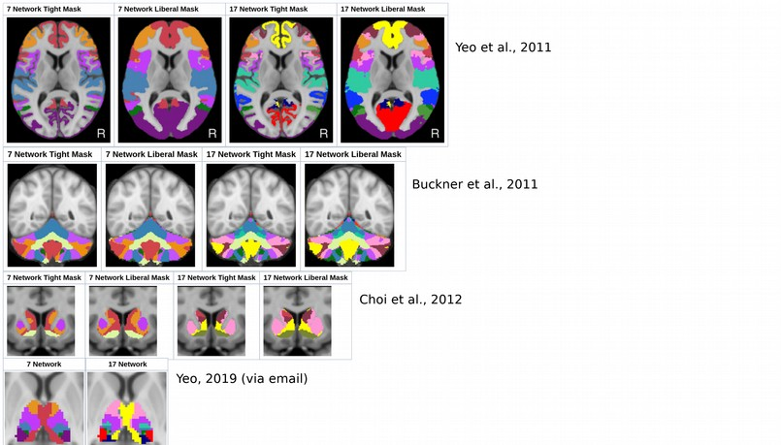
A Steady Progression of Regions

Slide 5
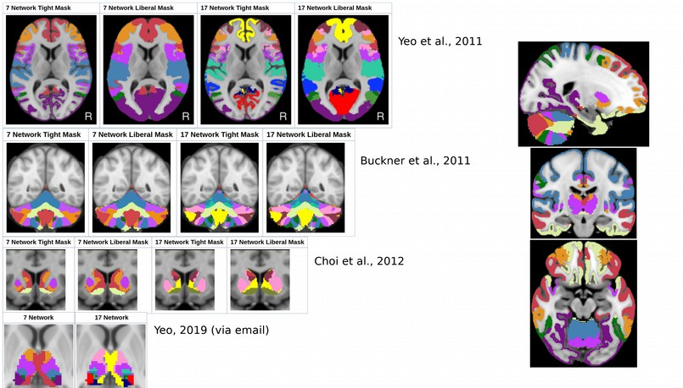
Areas of Concern

Slide 6
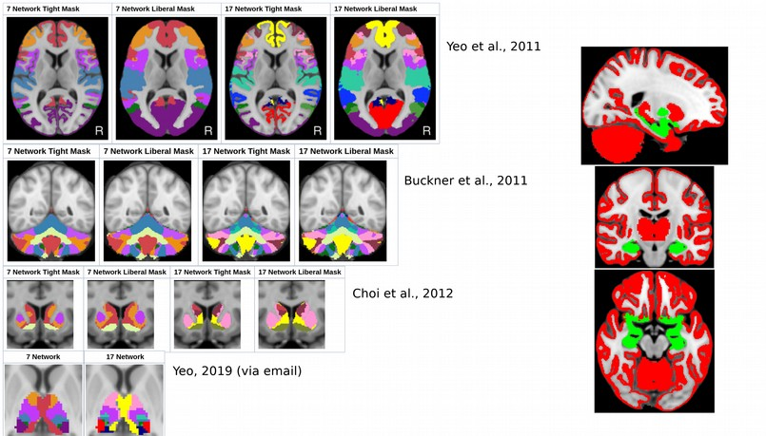
Missing Voxel Mask

Slide 7
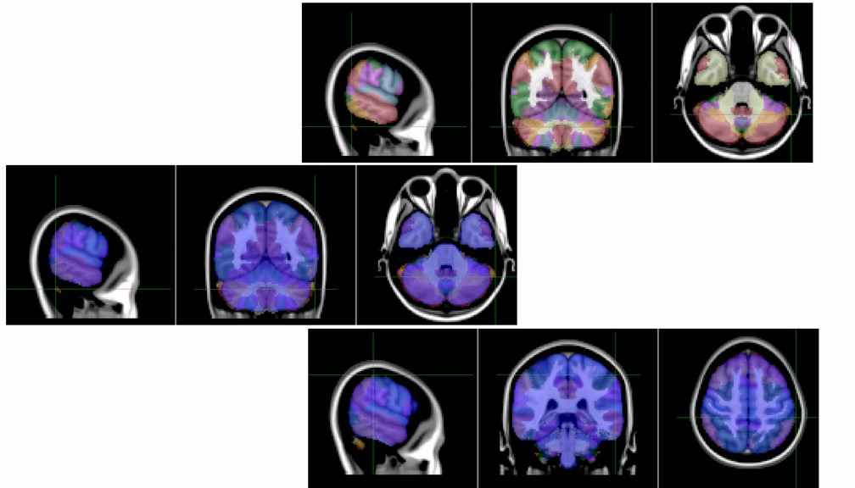
Supplemental Woes

Slide 8
Processing Tools
Bash
Matlab
R
AFNI, FSL

Slide 9

Processing Tools
Bash
Matlab
R
AFNI, FSL
No Python, Docker or Argon!

Slide 10
Input rsfMRI
303 Subjects from MGH Superstruct, 62 Subjects from NKI Rockland
MGH: 240 x 3s TR (12 minutes), smoothed (4mm) and unsmoothed
NKI: 900 x 0.65s TR (9.75 minutes) smoothed (4mm); 120 x 2.5s TR (5 minutes) unsmoothed
All data preprocessed via AFNI using CompCor, Friston-24 motion parameters. No GSR

Slide 11
Created a missing voxel query mask (binary) for empty regions of interest, excluding voxels that fell within Yeo 7/17 cortical, Buckner cerebellum, Choi Striatum, Yeo Thalamus
Focused on MTL, Pallidum, Basal Forebrain/Hypothalamus
Masks for both Tight and Liberal Network configurations
Thalamus parcellation was Tight only
fslmeants with Yeo 7/17 cortex (Liberal and Tight) to generate mean timecourses within Network regions
Clipped subject 4D residuals to query mask voxels
WTA Preprocessing

Slide 12
WTA Blueprint
Create an empty array the size of query mask (91 x 109 x 91), eventually write WTA data here
Load in the query mask, find indices >0 (where mask exists).
Tight mask has 2921 indices, Liberal has 2722.
Indices can be converted to x/y/z array coordinates. e.g.: Index 21372 = 34,60,22. Matlab x/y/z coordinates start with “1” whereas a viewer, such as fslview, uses a “0” numbering system (would be 33,59,21 (voxel coordinates) in MNI152 2mm space)
Create an empty structure
For each index (query mask voxel) there is an empty field that is the size numSubs x numNetworkParcels (e.g. MGH: 303 x 7, 303 x 17; NKI: 63 x 7, 63 x 17)
For every subject, load in Yeo 7/17 Network timecourses, clipped 4D residual.
For every query mask voxel, calculate timecourse
Calculate Pearson’s correlation between query voxel and each of the Yeo 7/17 Networks
Populate the empty structure
Create average of all “N” subjects
Largest average correlation is the winner
Populate empty array (at voxel coordinate) with the winner Network value
Repeat for every other missingMask voxel, Yeo 7/17, Tight/Liberal, with both smoothed and unsmoothed residuals.

Slide 13
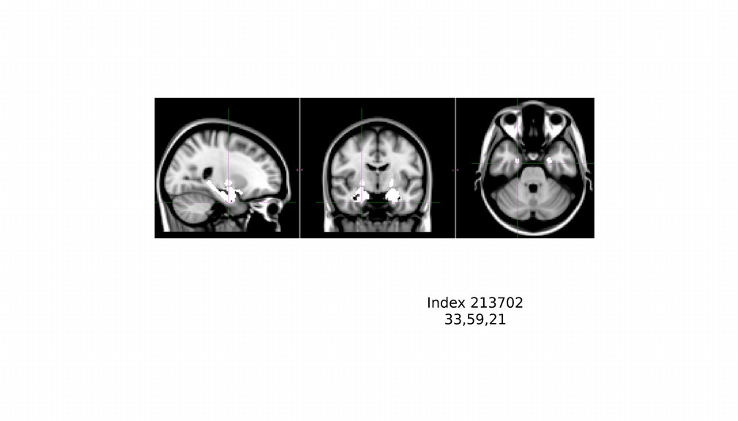
WTA, Query Voxel

Slide 14
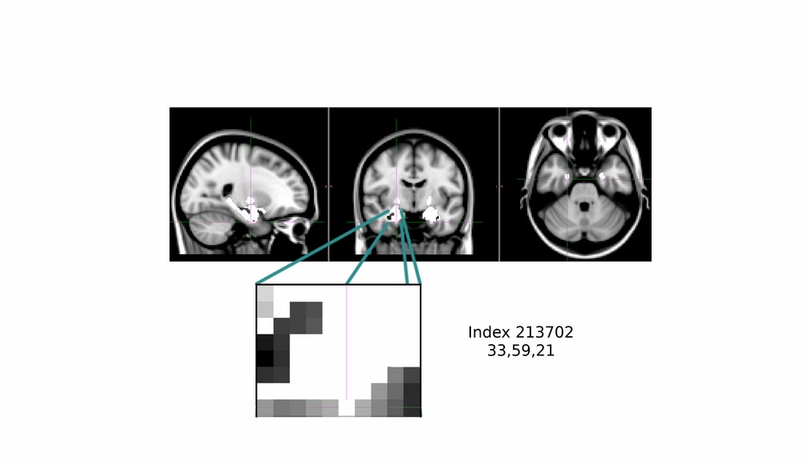
WTA, Query Voxel

Slide 15
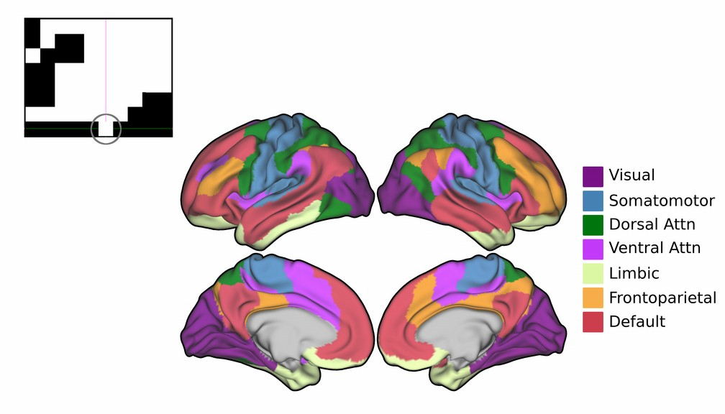
WTA, Setup

Slide 16
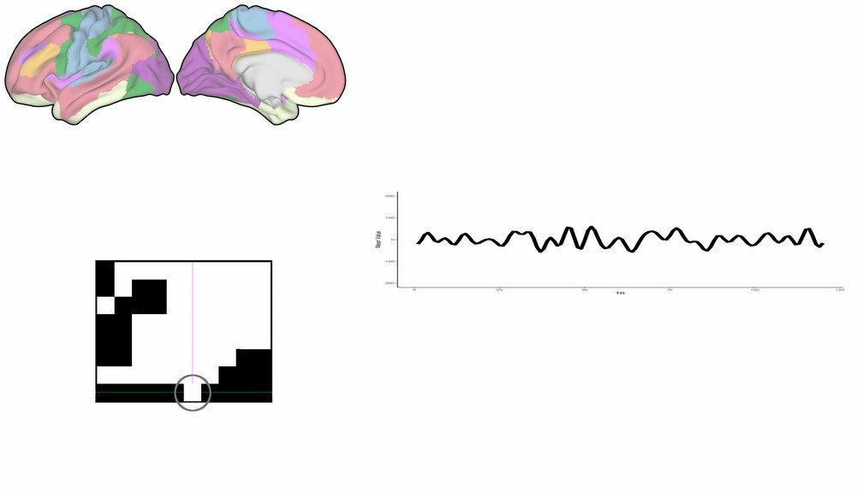
WTA, Query Voxel Timecourse

Slide 17
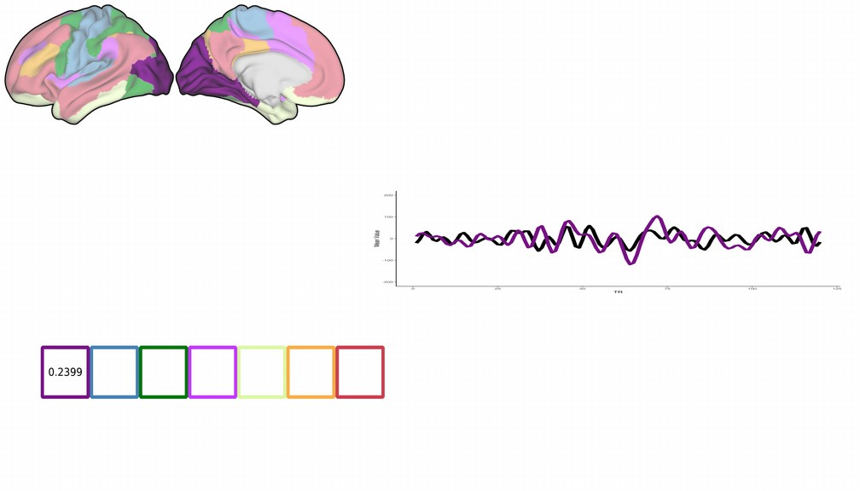
Yeo 1 (Visual)

Slide 18
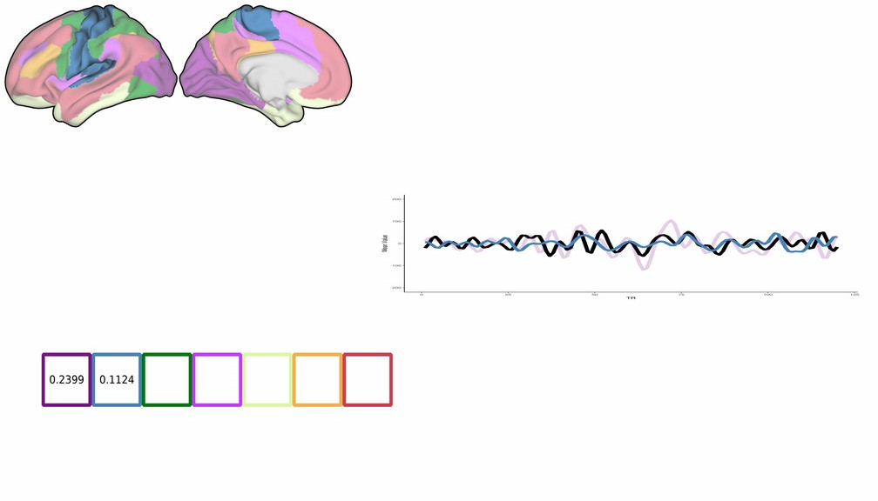
Yeo 2 (Somatomotor)

Slide 19
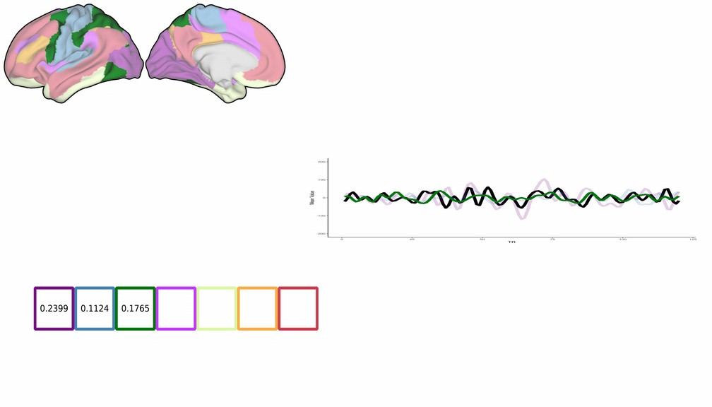
Yeo 3 (Dorsal Attn.)

Slide 20
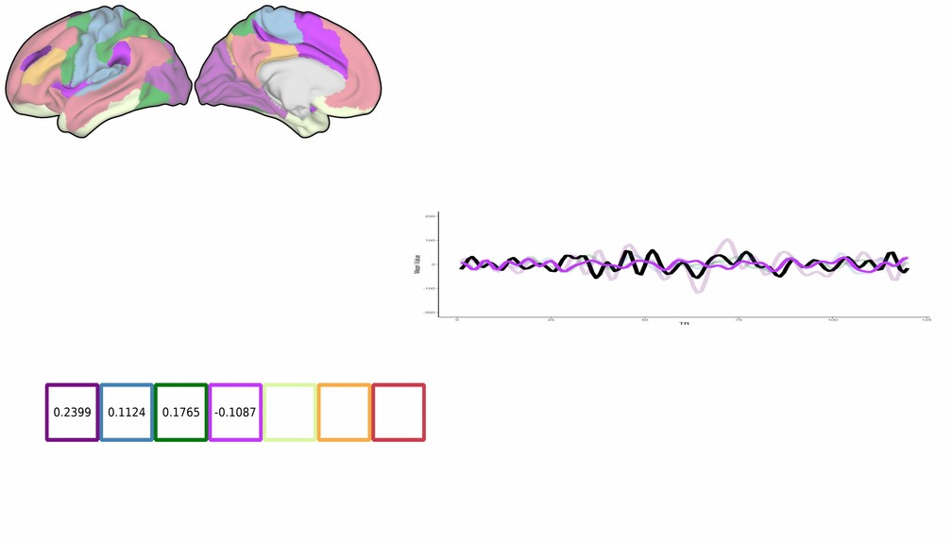
Yeo 4 (Ventral Attn.)

Slide 21
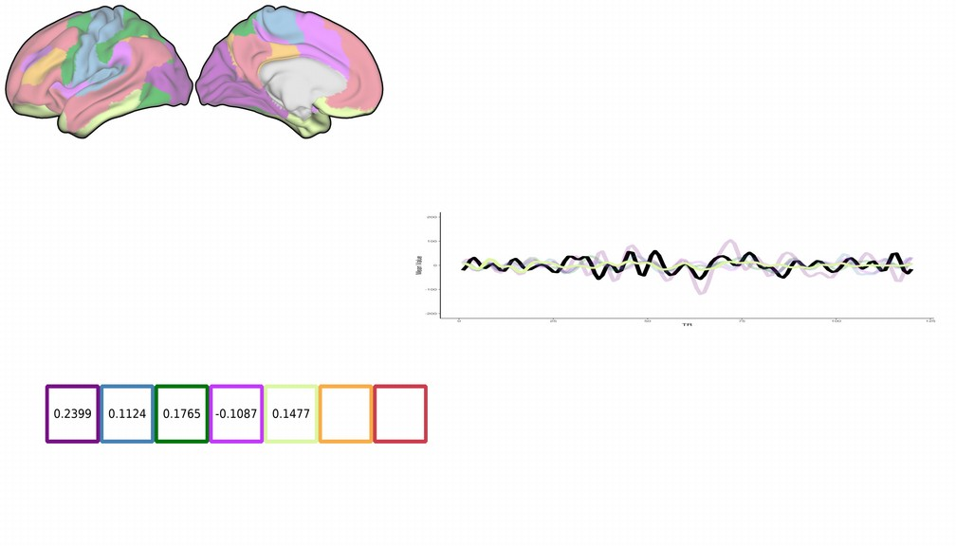
Yeo 5 (Limbic)

Slide 22

Yeo 6 (Frontoparietal)

Slide 23
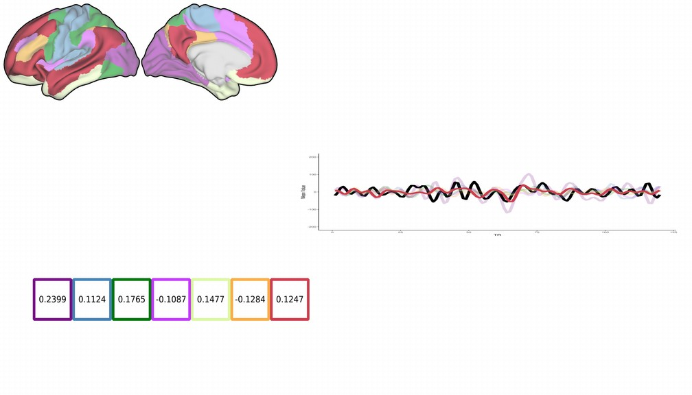
Yeo 7 (Default Mode)

Slide 24
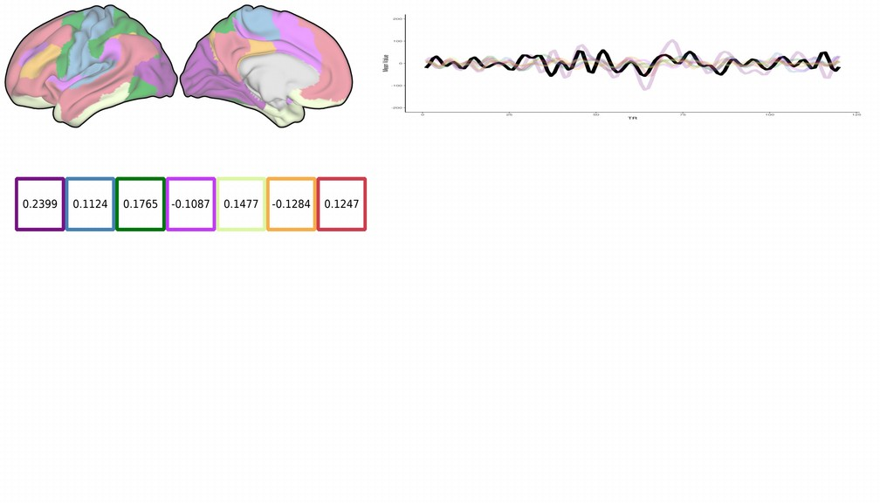
WTA, NKI, sub1

Slide 25
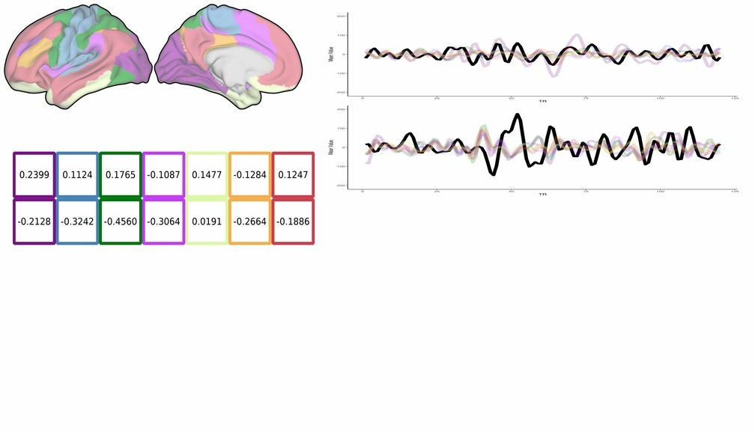
WTA, NKI, sub2

Slide 26
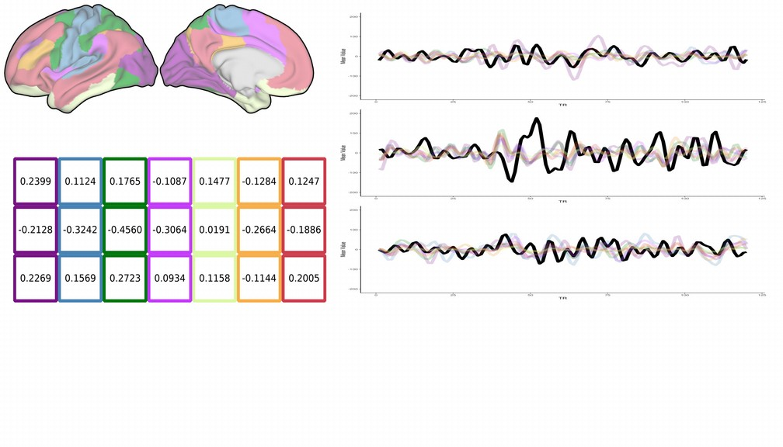
WTA, NKI, sub3

Slide 27
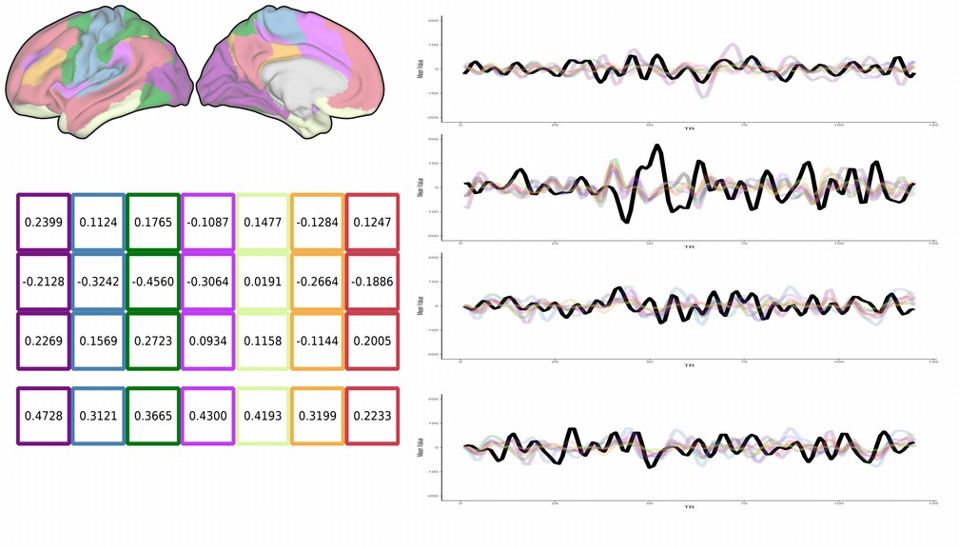
WTA, NKI, sub63 (end)

Slide 28
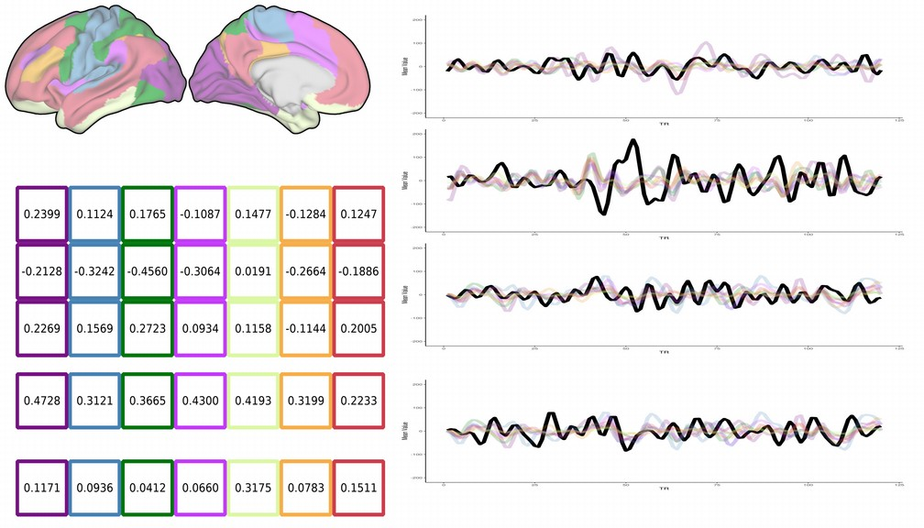
WTA, NKI, Average

Slide 29
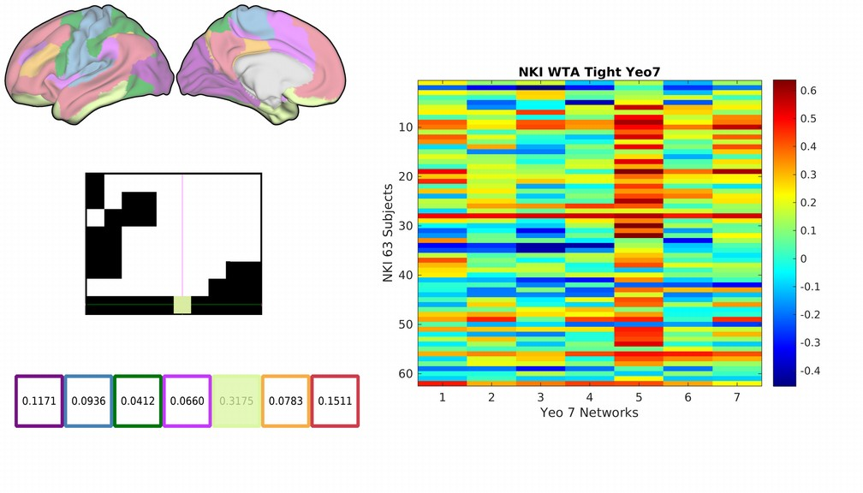
WTA, Query Voxel Winner (Limbic)

Slide 30
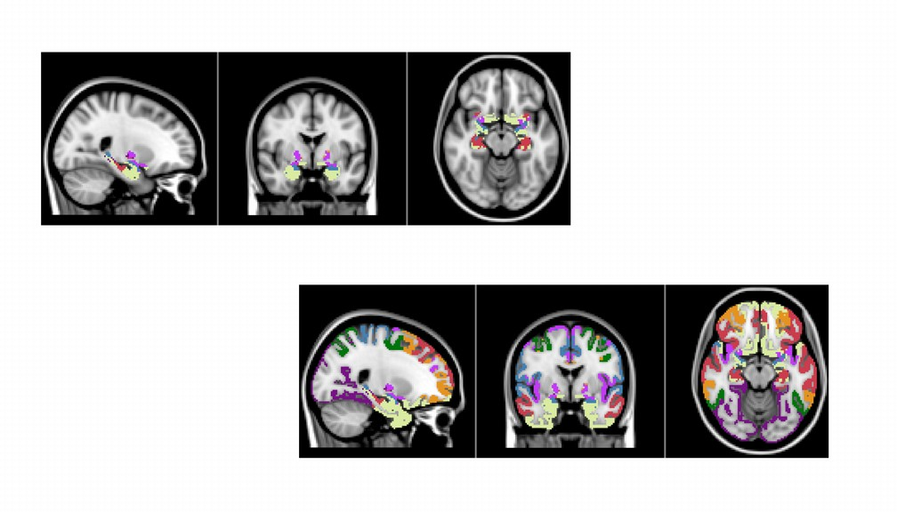
Remaining Voxels

Slide 31
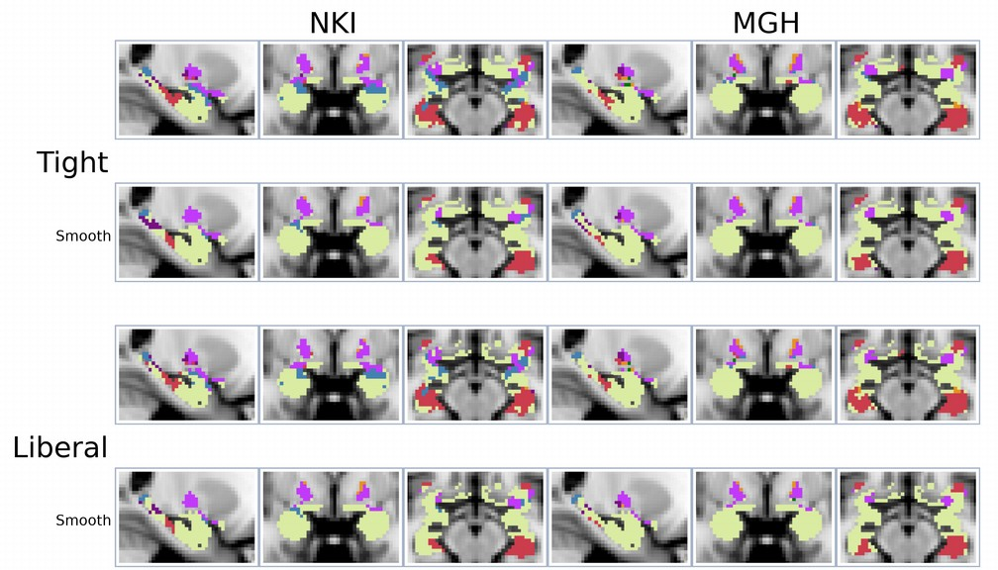
WTA Results, Yeo 7 Networks

Slide 32
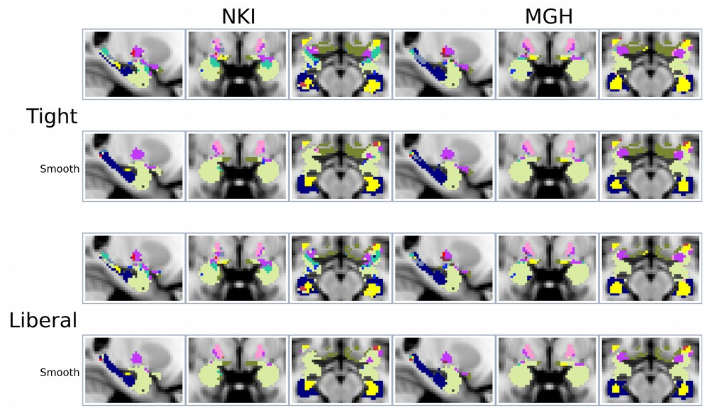
WTA Results, Yeo 17 Networks

Slide 33
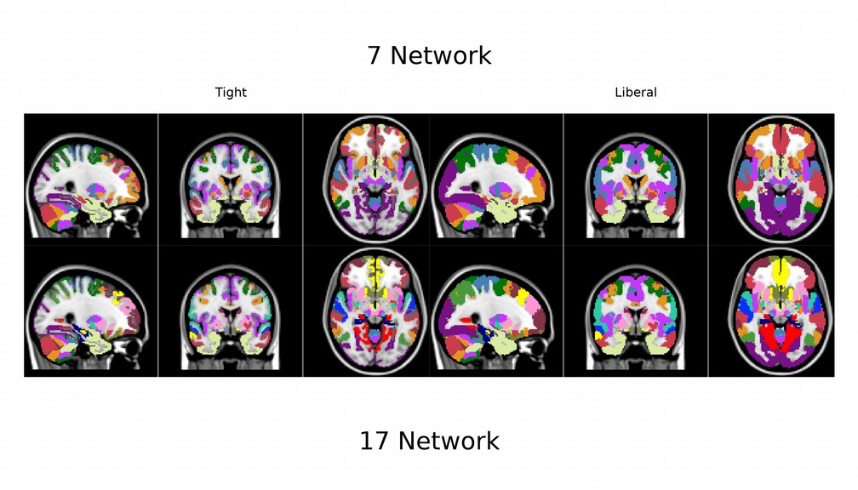
Putting It All Together

Slide 34
Next Steps
Split into Left and Right hemispheres
Determine number of clusters in each network, per subnetwork
Relabel ROI/cluster (intensity) by Network (hemi), region
Cortex, Cerebellum, Striatum, Thalamus, WTA
Left hemi, then Right hemi
LH_cortex_Visual_1….RH_WTA_Default_5….
Create files for xcpEngine
CommunityAffiliation
CommunityNames
NodeIndex
NodeNames

Slide 35
Using MGH, smooth:
7 Network, Liberal, 212 nodes
7 Network, Tight, 218 nodes
17 Network, Liberal, 425 nodes
17 Network, Tight, 415 nodes
Final mask sizes

Slide 36
Well, so what?

Slide 37
Correlations!

Slide 38
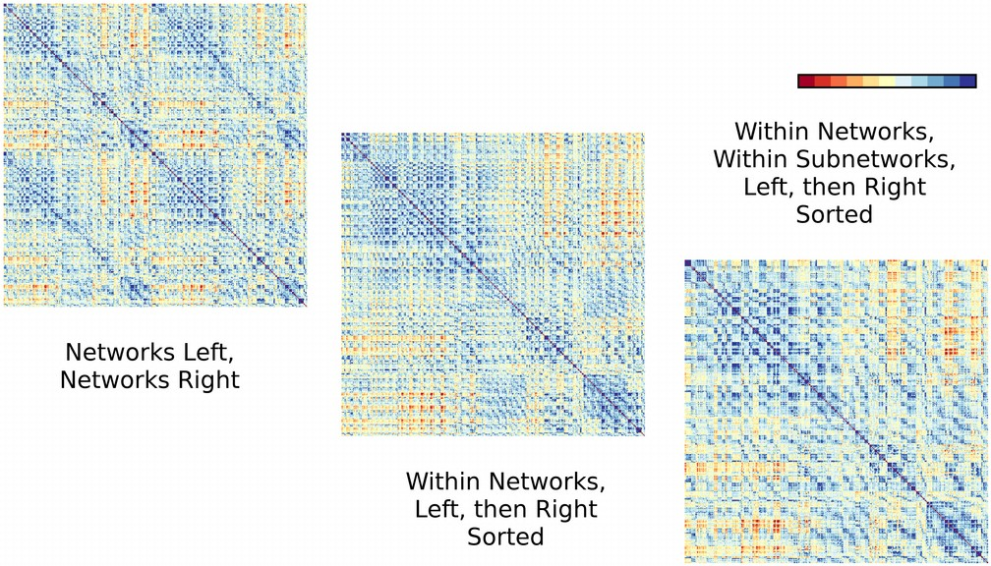
Network Sorting

Slide 39
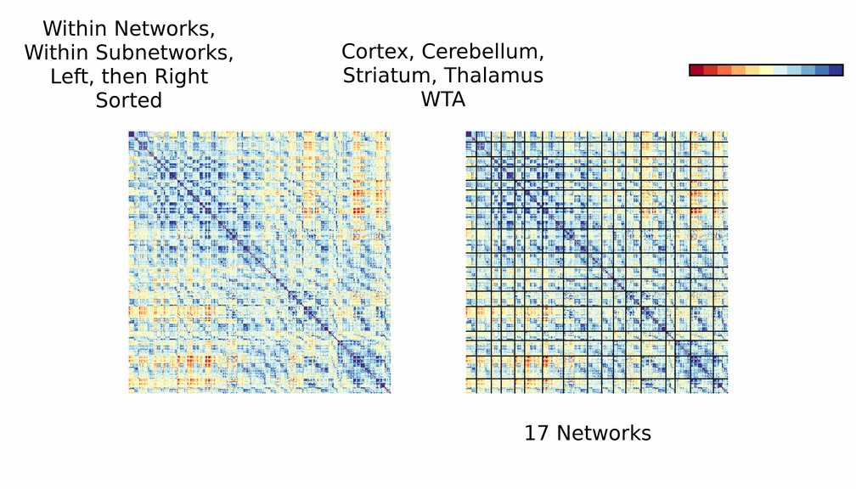
Final Sort

Slide 40
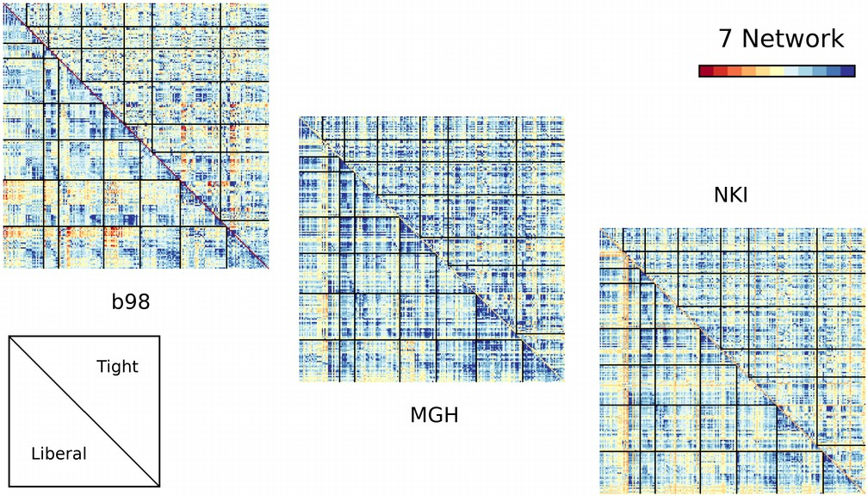
7 Networks

Slide 41
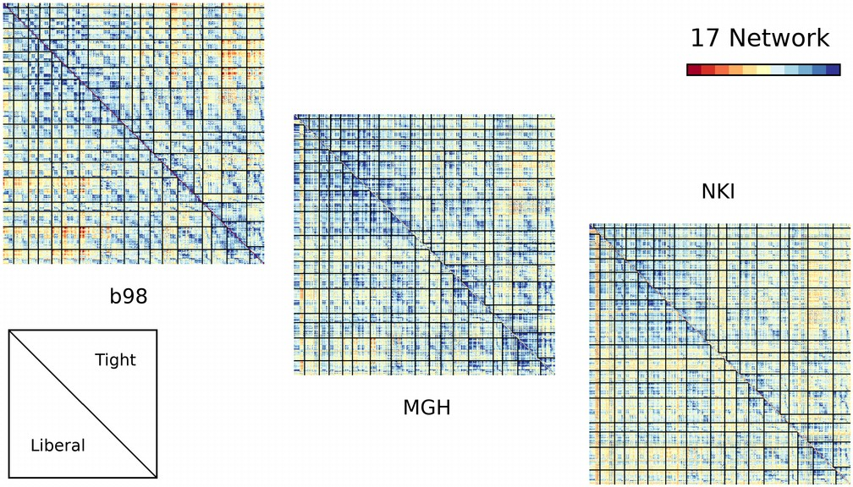
17 Networks

Slide 42
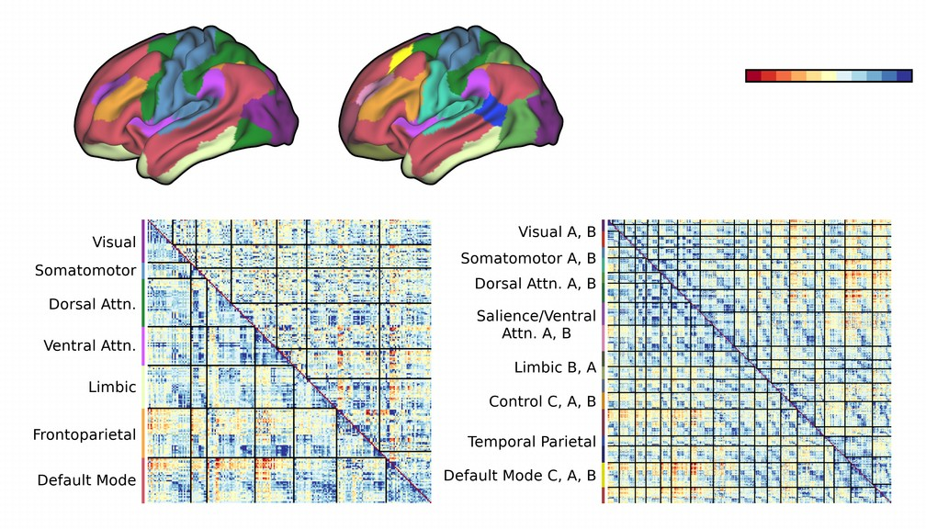

Slide 43
Is it OK to use the Cortex to derive networks
elsewhere in the brain?

Slide 44
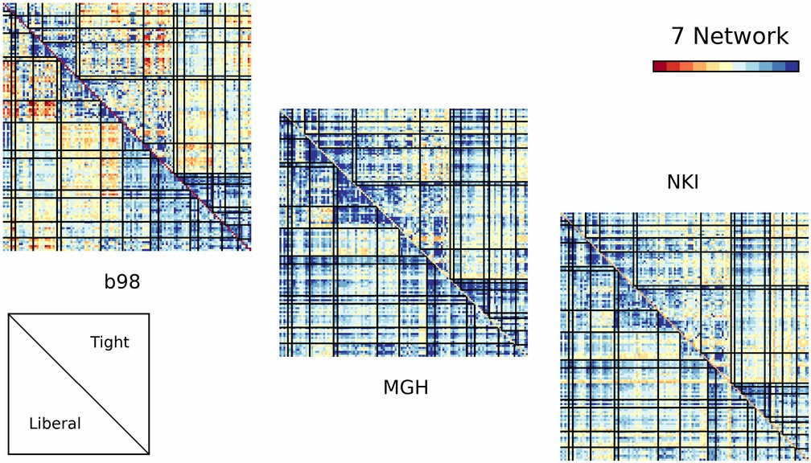
Cortex to Cerebellum Connectivity?

Slide 45
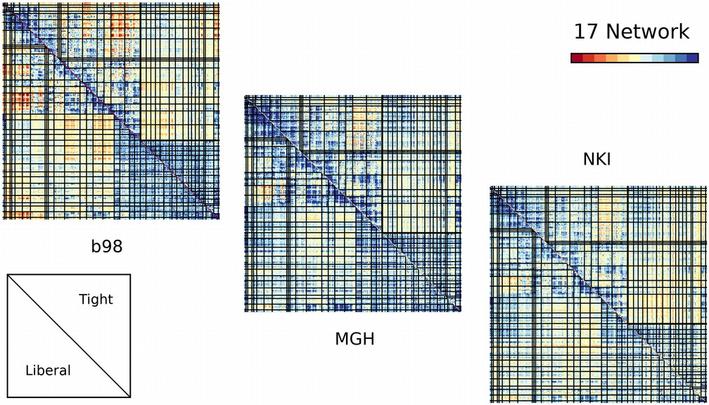

Slide 46
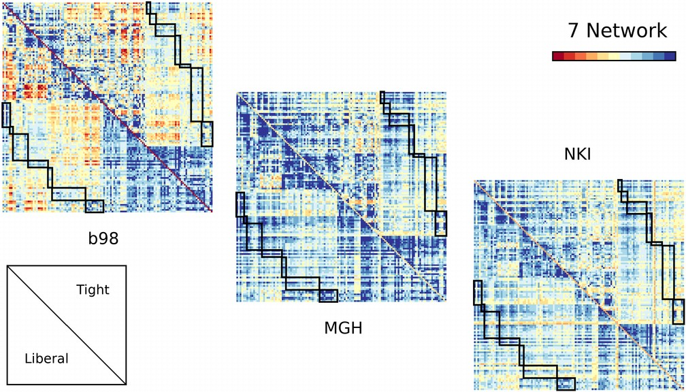

Slide 47
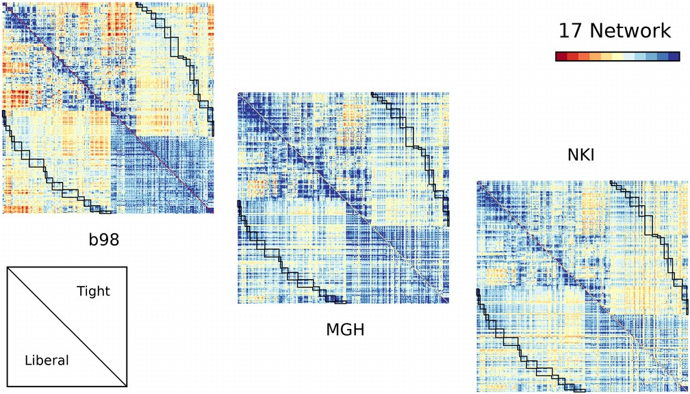

Slide 48
And, finally…..

Slide 49
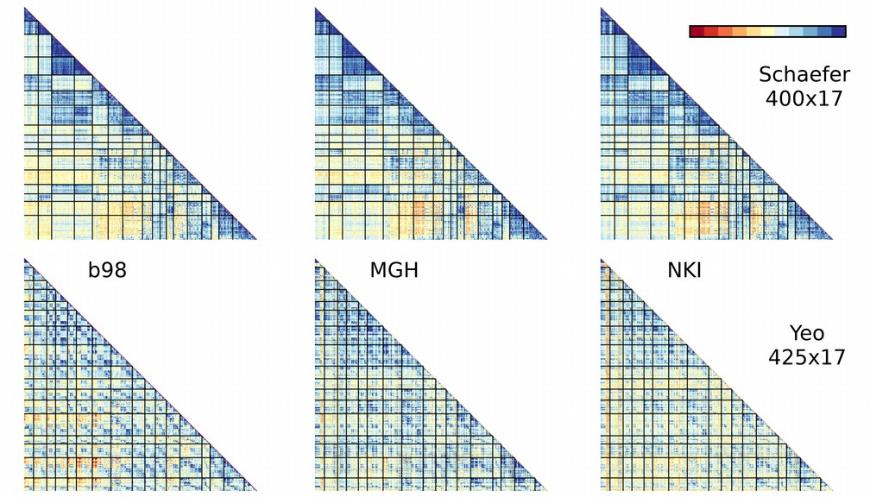
Schaefer (Cortical) & Yeo (Whole Brain)

Slide 50
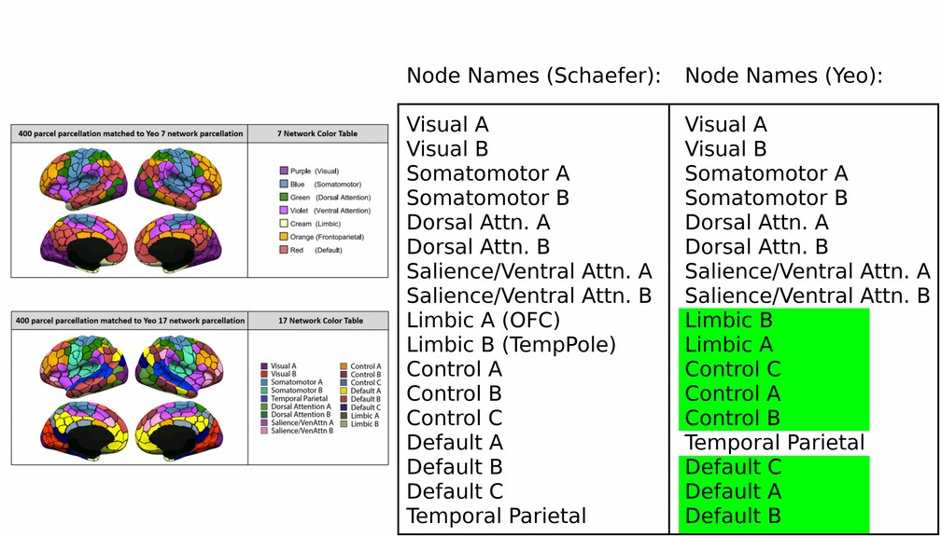
Caution!

Slide 51
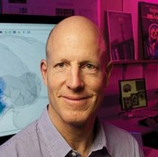
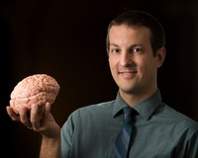

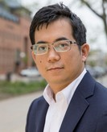
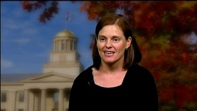
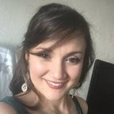

Thank You
Dan Tranel
Aaron Boes
Kai Hwang
Michelle Voss
Adriana Rivera-Dompenciel

